Slide 1


CSE 591 Data Visualization
Ross Maciejewski
rmacieje@asu.edu

Slide 2

Class Time and Location
Class Time: M W 3:00 – 4:15 PM
Class Location: BYAC 270
Office Hours (BYENG 344): M W 4:15 – 5:15PM
Please send an email if you intend to come to office hours
I try to be flexible, so you can also setup a different meeting time per email
E-mail: rmacieje@asu.edu

Slide 3




My Background
Before ASU
University of Missouri – Columbia, MO
Purdue University – West Lafayette, IN
Education
PhD/MS in Computer Engineering – Purdue University
BS in Computer Science, Electrical Engineering and Computer Engineering – University of Missouri

Slide 4
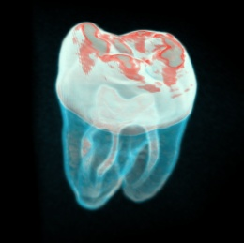
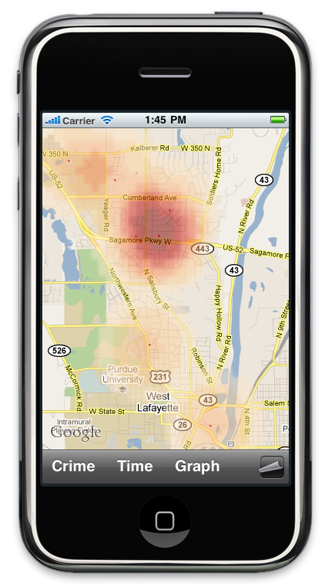

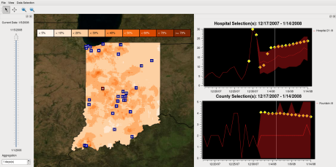

My Research
Visual Analytics
Information Visualization
Computer Graphics
Healthcare Analytics
Crime Analytics

Slide 5
Class Information
Class uses blackboard/myASU interface:
Syllabus
Slides
Homework
Projects
Announcements

Slide 6
Grades
A+ [97–100] A [93–96] A- [90-92]
B+ [87–89] B [83–87] B- [80–82]
C+ [77–79] C [70–77]
D [60-69]
E [0–60]
I might choose to improve the grades by lowering some cutoff values
I will definitely not increase the cutoff values
If you ask me what grade you need to get in class, this is what I will tell you. Grades may be curved, but that is unlikely.

Slide 7
Grades
Group Project: 40%
Midterm: 15%
Final exam: 20%
In Class Quizzes 10%
Homework 15%
Participation: up to -20% for lack of attendance, lack of participation, or disrupting the class (for severe cases only)

Slide 8
Exams and Quizzes
Closed Book
Fixed Duration
There will be 6 Quizzes, your lowest quiz score will be dropped
No make-up quizzes will be given unless there are extenuating circumstances
Mid-term exam
Wednesday, March 5th (tentative), 3:00 pm – 4:15 pm BYAC 270
Final exam
May 7th 12:10-2PM, TBD

Slide 9
Missing an Exam
If you miss a mid-term or the final exam
If you have a very important reason not to be here we can certainly find a solution
You need written documentation(!) to state your case
You need to notify me as soon as possible
Any make up test will be more difficult

Slide 10
Assignments
You will have 8 small data visualization and analysis assignments
Assignments will each be 1 week long
The lowest assignment grade will be dropped
No late assignments will be accepted

Slide 11
Group Project
You will form a team of 2-4 students with workload expectations being based on team size
You will identify a problem area and data set for analysis and develop an interactive visualization tool for analyzing the data
You are free to use any software development environment or graphics/visualization support library
Consider developing a web-deployable system to share your work with the world

Slide 12
Group Project
Milestone 1 (10%) – January 29th – Initial project description
Milestone 2 (30%) – February 26th – Project design ideas. Design ideas and a storyboard/mockup of visualizations
Milestone 3 (30%) – April 14th – Project demonstration.
Milestone 4 (30%) – April 30th – Final project documentation, source code and video due
See more details on the full description on blackboard, Milestone 1 is now assigned.

Slide 13
Class Participation Time
Introduce yourself to your neighbor!
Talk to your neighbor, ask them about their research, make new friends and discuss project teams.
Meet at least one person you didn’t know before class today.

Slide 14
Workload
Arizona Board of Regents Suggests: 2-3 hours outside class for each hour in class!
That means 6-9 hours of work outside of class. If you miss the class you will need more time.

Slide 15
How Can I Improve My Grade?
There in NO extra credit
Your grade reflects your work throughout the entire semester
If you want a good grade, start each assignment on time, turn the assignments in on time and study for the exams
http://www.youtube.com/watch?v=WVvKnq5XT-g&feature=share
Please Note: It is unethical to bring to your instructor's attention the possible impact of your course grade on your future plans, including graduation, scholarships, jobs, etc.

Slide 16
Academic Integrity
Violations of academic integrity include (but are not limited to) cheating, fabrication, tampering, plagiarism or facilitating such activities.
I have a zero tolerance policy. Any perceived cheating will be sent to the provost and dismissal from the university will be recommended.
A student asking you to raise his/her grade for any other reason than a computational or instructor error is in violation of ASU's Academic Integrity Policy, section N:
For details see:
https://provost.asu.edu/files/AcademicIntegrityPolicyPDF.pdf

Slide 17
Academic Integrity
Cheating on Exams
Copying from another’s test paper.
Making a copy of a test and giving it to someone or using a test if someone gives it to you.
Using technology to take a test for someone or asking someone to take a test for you.
Inappropriate Collaboration
Working with others when you should be doing the work individually.
http://clas.asu.edu/files/AI%20Flier.pdf

Slide 18
Classroom Behavior
No cell phones (No texting/facebooking/etc.)
No Food / Drinks (Drinks with appropriate lids are ok, but the first spilled drink will result in a class ban)
Participation is expected!

Slide 19
Attendance Policy
Attendance is required
Announcements are made in class
Announcements might not be on the web pages, but I will try to post all important information on myASU
If you come to class, you will be expected to participate
Your grade may suffer due to lack of attendance, random attendance may be taken to help assess participation

Slide 20
Disability Resource Center
Disability Resource Center for Academic Access: If you have a disability that will require accommodation in this class, please schedule an appointment or see me during office hours to discuss your accommodation request.
Note: To qualify for disability accommodations here at ASU, students must register and qualify for services through the Disability Resource Center for Academic Access and Achievement (DRC) located on the 1st Floor of Matthews Center, Room 143, 480-965-1234 (V), 480-965-9000 (TTY).

Slide 21
Prerequisites
Programming Skills
C++/Java/Language of choice
Ability to write medium size programs

Slide 22
What will we cover in class?
Purposes and goals of visualization:
applications, challenges, sources of data
measurement, simulation, modeling
data dimensionality: 1D, 2D, 2.5D, 3D
time-dependent
data types: scalar, vector, nominal, multivariate
grid types: regular, rectilinear, curvilinear, unstructured, hybrid, point-based or scattered data

Slide 23
Skills you will take away
You will know the basics of designing effective visualizations
You will gain knowledge of statistical graphics
You will learn a variety of data analysis techniques
You will learn more skills for analyzing data

Slide 24
Questions?

Slide 25
What is Data Visualization?
Ross Maciejewski
Assistant Professor Computer Science Arizona State University

Slide 26
The Ongoing Data Deluge
Since 2003, digital information has accounted for 90% of all information produced¹
In 2009, drones from Iraq and Afghanistan recorded 24 years of video footage
In 2010, the amount of information added annually to the digital universe was estimated to be nearly 1 ZB
Wal-mart process > 1 million transactions per hour
By 2013 Cisco estimates the annual internet traffic will be 667 EBs
1 – C. R. Johnson, R. Moorhead, T. Munzner, H. Pfister, P. Rheingans, and T. S. Yoo, Eds., NIH-NSF Visualization Research Challenges Report, IEEE Press, ISBN 0-7695-2733-7, 2006
Notes:
A few industries have led the way in their ability to gather and exploit data. Credit-card companies monitor every purchase and can identify fraudulent ones with a high degree of accuracy, using rules derived by crunching through billions of transactions. Stolen credit cards are more likely to be used to buy hard liquor than wine, for example, because it is easier to fence. Insurance firms are also good at combining clues to spot suspicious claims: fraudulent claims are more likely to be made on a Monday than a Tuesday, since policyholders who stage accidents tend to assemble friends as false witnesses over the weekend. By combining many such rules, it is possible to work out which cards are likeliest to have been stolen, and which claims are dodgy.
Mobile-phone operators, meanwhile, analyse subscribers’ calling patterns to determine, for example, whether most of their frequent contacts are on a rival network. If that rival network is offering an attractive promotion that might cause the subscriber to defect, he or she can then be offered an incentive to stay. Older industries crunch data with just as much enthusiasm as new ones these days. Retailers, offline as well as online, are masters of data mining (or “business intelligence”, as it is now known). By analysing “basket data”, supermarkets can tailor promotions to particular customers’ preferences. The oil industry uses supercomputers to trawl seismic data before drilling wells. And astronomers are just as likely to point a software query-tool at a digital sky survey as to point a telescope at the stars.

Slide 27
The Ongoing Data Deluge
FedEx’s ships more than 8.5 million packages per day (http://www.fedex.com/us/about/today/companies/corporation/facts.html)
Consumers carry more than 1 billion Visa cards worldwide. More than 450 million of those cards are in the United States (http://www.creditcards.com/credit-card-news/credit-card-industry-facts-personal-debt-statistics-1276.php)

Slide 28
Data Overload
Opportunity: Huge amounts of data available in digital form and ready for analysis!
But, how can we make sense of this data?
How can we harness this data in the decision making process?
How do we avoid being overwhelmed by all of this data?

Slide 29
The Power of Visualization
The goal is to take all of this data and transform it into information
How many terabytes of data we have collected doesn’t matter, it’s how many petaflops of insights we can generate from this data
“The purpose of computing is insight, not numbers.” Dedication to his book: RW Hamming (1971). Introduction to Applied Numerical Analysis. McGraw Hill.
We need to make the data understandable to people and a key way of doing this is through visualization

Slide 30
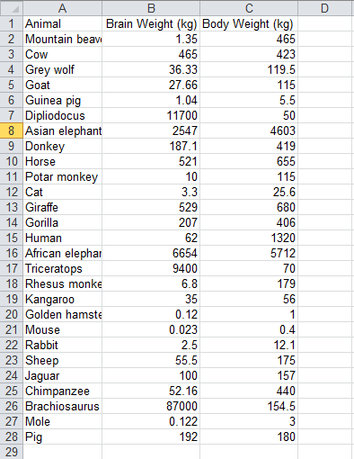
Which animal weights the least/most?
Is there a relationship between brain weight and body weight?
If so, are there any outliers?
Rousseeuw, P.J. & Leroy, A.M. (1987) Robust Regression and Outlier Detection. Wiley, p. 57

Slide 31
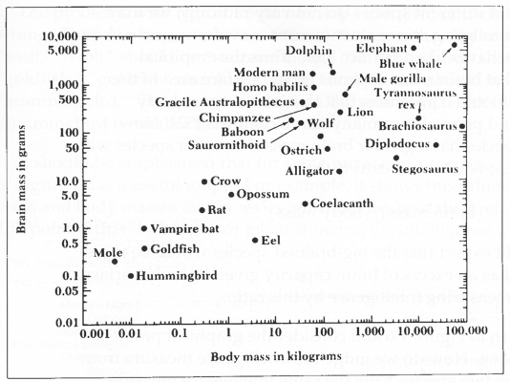
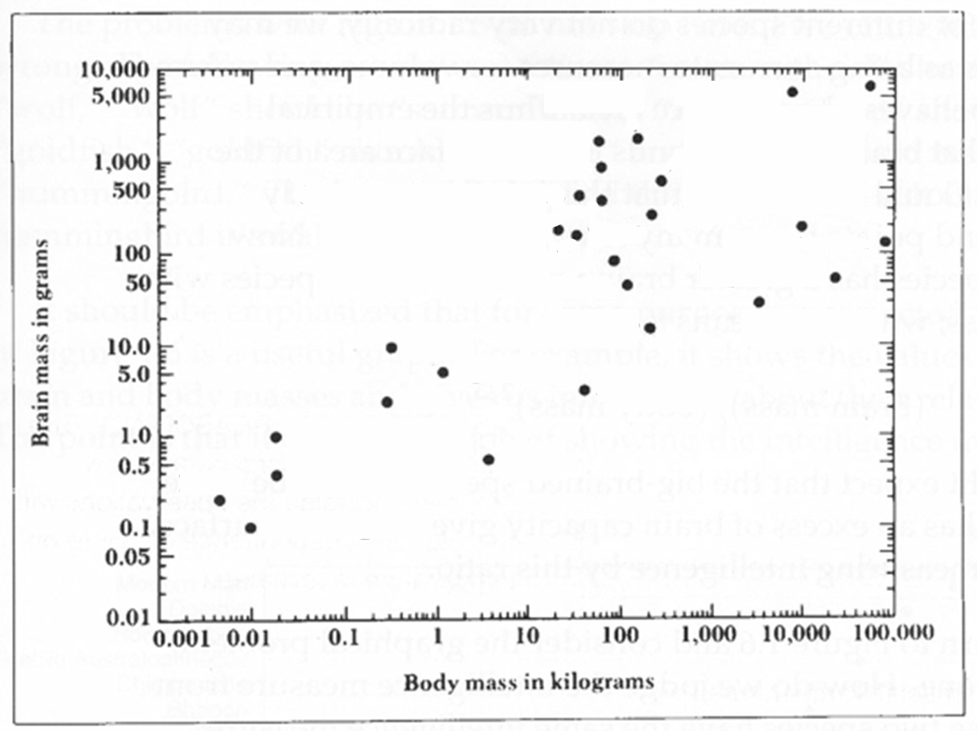

Slide 32
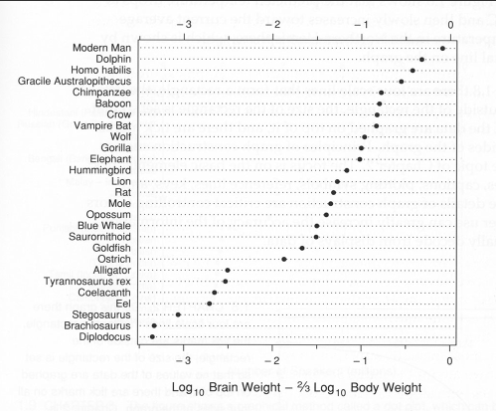
WS Cleveland – The Elements of Graphing Data, 1994

Slide 33
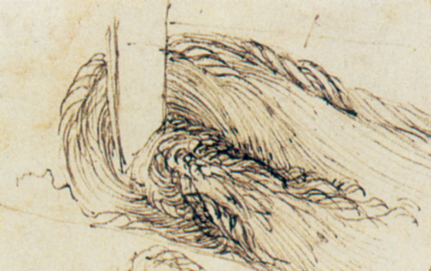
Visualization Through the Ages
Hand-drawn illustration¹ of water by Leonardo da Vinci from his studies to determine the processes underlying water flow (1510)
1 – Leonardo da Vinci. Old Man Seated on Rocky Outcrop, Seen in Profile to the Right, with Water Studies. Windsor Castle, Royal Liberty, RL 12579r, c. 1510-1513.

Slide 34
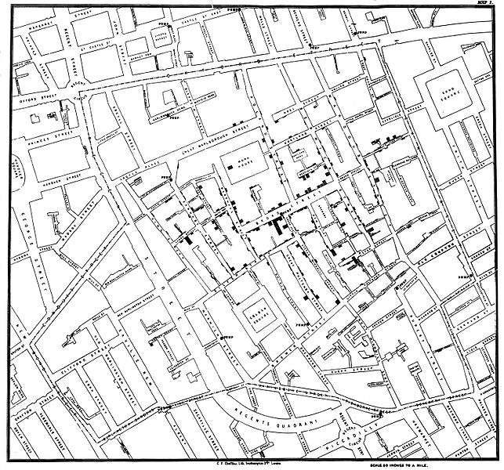
Visualization Through the Ages
John Snow’s map of Cholera cases in the London epidemic of 1854¹
1 – The Visual Display of Quantitative Information, E. R. Tufte, 1983

Slide 35

Visualization Through the Ages
Charles Minard’s 1869 flow map¹ showing Napoleon’s disastrous Russian campaign of 1812.
1 – Charles Joseph Minard: Mapping Napoleon’s March, 1861 by John Corbett, Center for Spatially Integrated Social Science

Slide 36
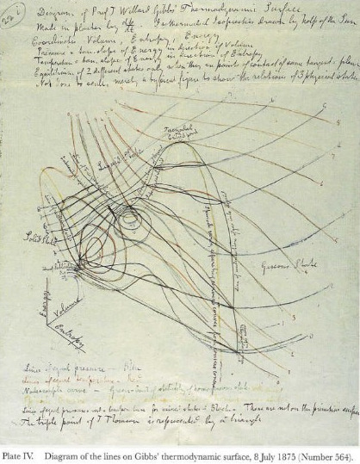
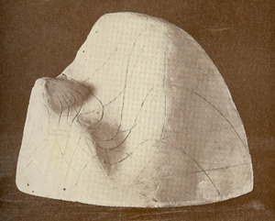
Visualization Through the Ages
James Maxwell’s¹ thermodynamic surface sculpture (1874)
Three-dimensional plot of the states of a fictitious water-like substance
Coordinates are volume (x), entropy (y), and energy (z)
1 – James Clerk Maxwell and P. M. Harman (2002), The Scientific Letters and Papers of James Clerk Maxwell, Volume 3: 1874-1879, Cambridge University Press

Slide 37
Visualization Through the Ages
1936 American Journal of Cancer XXVII. P. 49: “The hexagonal tube … offers distinct advantages with its flat sides permitting good visualization”
1973 Nature 17 Aug. P. 410-11: “Direct visualization of biological material at this level would tell us much about the structure and mode of action macromolecules.”
Visualization in Scientific Computing ACM SIGGRAPH Computer Graphics, 21(6) – Special Issue, 1987.
1 – The first two citations on this page are borrowed from Pat Hanrahan’s “The Purpose of Visualization” lecture: http://graphics.stanford.edu/courses/cs448b-04-winter/lectures/purpose/walk003.html

Slide 38
Why is Visualization Helpful?
It utilizes the high bandwidth of the human visual systems
The human mind is fast and parallel
Humans are great at visual pattern recognition
We have pre-attentive visual phenomena
Visual tools can extend memory and cognitive capacity
We think visually!
“A picture is worth a thousand words.” – Printers Ink, pp. 96-97 December 8, 1921

Slide 39
Is a Picture Worth a Thousand Words?
Diagram have relationships defined within them (topological and geometric)
Information can be indexed and ordered in logical sequences
Information is processed differently when presented in textual form as opposed to diagrammatically
Diagrams have the ability to group information spatially which can reduce the search process as well as support perceptual inferences where are difficult to make from text
1 - Larkin, J. & Simon, H. (1987) Why a diagram is (sometimes) worth ten thousand words. Cognitive Science, 11:65-992

Slide 40
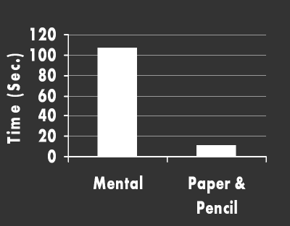
Let’s Exercise Our Brain
207
x 52
414
10350
10764
1 – The image on this page is borrowed from Pat Hanrahan’s “The Purpose of Visualization” lecture: http://graphics.stanford.edu/courses/cs448b-04-winter/lectures/purpose/walk003.html

Slide 41
Why Is Visualization So Helpful?
Amplifies cognition
Expands our working memory by allowing us to offload results
Reduces the search time
Pattern detection and recognition can be improved through perceptual cues and inference
Visualizations can be designed to control attention interaction for improving cognition
Readings in Information Visualization: Using Vision to Think, SK Card, J Mackinlay and B.Shneiderman, 1999

Slide 42
What is Visualization?
“The use of computer-supported, interactive visual representations of data to amplify cognition.”¹
This is not simply the process of making a graphic or an image, the goal is to create insight, not pretty pictures
We want to help people form a mental image of something and internalize their own understanding
We want to promote discovery, decision making and explanations
1-Readings in Information Visualization: Using Vision to Think, SK Card, J Mackinlay and B.Shneiderman, 1999

Slide 43
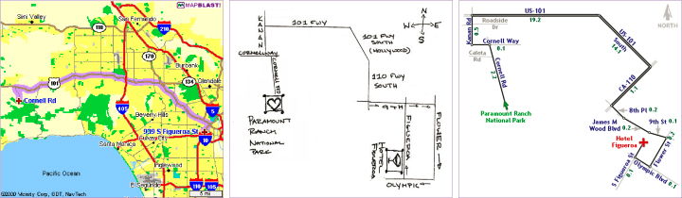
What is Visualization
We want to find and utilize cognitive and perceptual principles
We want to optimize our visualizations and our interactions with the visualization according to these principles
Maneesh Agrawala, Chris Stolte: Rendering effective route maps: improving usability through generalization. SIGGRAPH 2001: 241-249

Slide 44
Scientific Visualization
Primarily relates to and represents something physical or geometrics
The structure of the data is typically defined or given
Examples
Air flow over a wing
Stresses on a girder
Organs in the human body
Molecular bonding
1 – Descriptions on this slide are borrowed from John Stasko’s “InfoVis Overview” lecture: http://www.cc.gatech.edu/~stasko/7450/Notes/overview.pdf

Slide 45
Information Visualization
Primarily relates to data that does not have a direct physical correspondence
Notion of the data is abstract
Examples
Baseball statistics
Stock trends
My social network
1 – Descriptions on this slide are borrowed from John Stasko’s “InfoVis Overview” lecture: http://www.cc.gatech.edu/~stasko/7450/Notes/overview.pdf

Slide 46
Purpose of Visualization
Analysis – Understand your data better and act upon that understanding
Given a data set, compare, contrast, assess, evaluate
Solve a problem!
Presentation – Communicate and inform others more effectively
Visualization is most useful in exploratory data analysis¹
1 – J. W. Tukey. Exploratory Data Analysis

Slide 47
“Information visualization is ideal for exploratory data analysis. Our eyes are naturally drawn to trends, patterns, and exceptions that would be difficult or impossible to find using more traditional approaches, such as tables or text, including pivot tables. When exploring data, even the best statisticians often set their calculations aside for a while and let their eyes take the lead.”
S. Few
Now You See It

Slide 48
The Information Seeking Mantra
Overview first,
then zoom and filter,
details on demand
1 - B. Shneiderman. The Eyes Have It: A Task by Data Type Taxonomy for Information Visualizations. In the Proceedings of the IEEE Symposium on Visual Languages, pp. 336-343, 1996.

Slide 49
Tasks for Visualization
Searching and browsing - find a specific piece of information, inspect data, seek information
Analyze – do comparisons, differences, look for outliers, extrema and patterns
Monitor – look for changes and trends

Slide 50
“Contained within the data of any investigation is information that can yield conclusions to questions not even originally asked. That is, there can be surprises in the data … To regularly miss surprises by failing to probe thoroughly with visualization tools is terribly inefficient because the cost of intensive data analysis is typically very small compared with the cost of data collection.”
W. S. Cleveland
The Elements of Graphing Data

Slide 51
Visual Analytics
Visualization is good for exploring data, but we can do more than just explore
“Visual analytics is the science of analytical reasoning facilitated by interactive visual interfaces”¹
Visual analytics combines automated analysis techniques with interactive visualizations for an effective understanding, reasoning and decision making on the basis of very large and complex data sets.²
“A graphic display has many purposes but it achieves its highest value when it forces us to see what we were not expecting.”³
1 - J. J. Thomas and K. A. Cook (Ed.). Illuminating the Path: The R&D Agenda for Visual Analytics. National Visualization and Analytics Center, 2005.
2 – Keim et al. chapter in Information Visualization: Human-Centered Issues and Perspectives, 2008.
3 – H. Wainer. A Graphic Discovery: A Trout in the Milk and Other Visual Adventures.

Slide 52
Challenges in Visualization
Scale
Challenge often arises when data sets become large
Diversity
Data is of varying types, forms, sizes
Evaluation
How can we prove that a visualization helped?
Benefits are not easily quantifiable and measured.

Slide 53
What will this course cover?

Slide 54
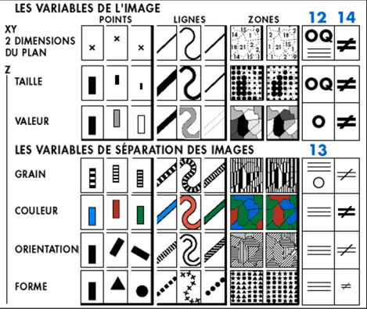
Data Representations
J Bertin. The Semiology of Graphics

Slide 55
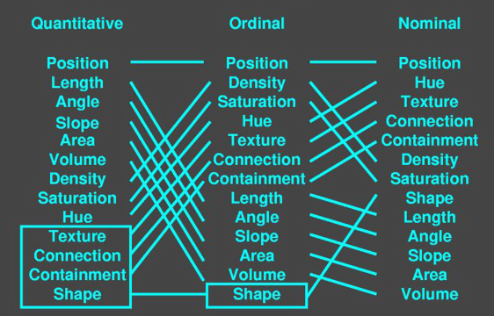
Perception and Cognition
J Mackinlay. Automating the Design of Graphical Presentations of Relational Information, ACM TOG 5:2, 1986.

Slide 56
Color
Rainbow
Sequential
Grayscale
Divergent
Qualitative
V₂
V₂
V₃
V₁
V₁

Slide 57
Interaction
"The capacity of vibrissae, hairs, claws, and horns to feel things at a distance is not different in principle from the ability of a man to use a cane or probe to detect the mechanical encounters at the end of the artificial appendage to his hand. The use of tools, from sticks, clubs, and rakes to more elaborate ones like screwdrivers and pliers or even fishing rods and tennis rackets, is probably based on a perceptual capacity of the body that is found in other animals. The remarkable fact is that when a man touches something with a stick he feels it at the end of the stick, not in the hand. This is a difficulty for the theory of sensation-based perception; it requires some such postulate as the projecting of sensations outward from the body. But we entertain the hypothesis that information for the mechanical disturbance at the end of the stick is obtained by the hand as a perceptual organ, including information about the length and direction of the stick. The sensations in the hand itself are irrelevant. The surface of an organism, it should be remembered, is actually a boundary between the organism and its environment, and the boundary is not always or everywhere as clean-cut as the hairless human philosopher tends to think.“
Gibson, J. J. The Senses Considered as Perceptual Systems. p.100-102]

Slide 58
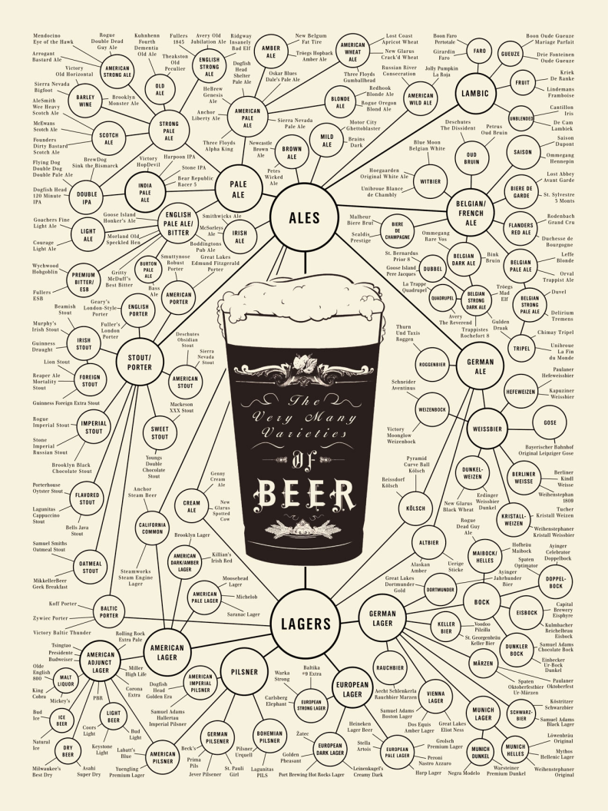
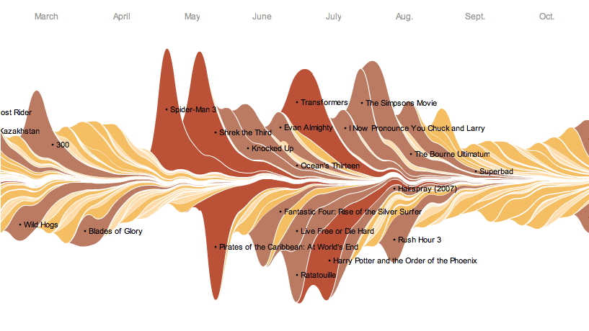
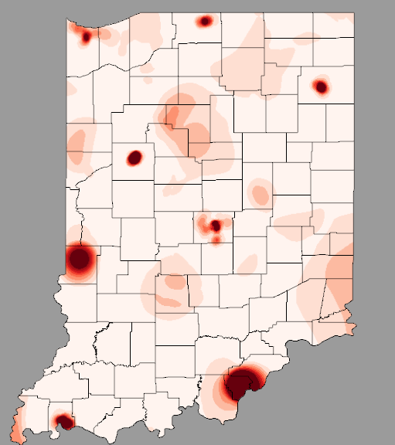
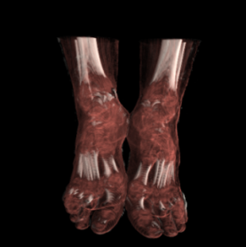
Visual Metaphors
http://images.fastcompany.com/upload/poster_beer_1300.jpg
* - Theme River Image from: http://www.nytimes.com/interactive/2008/02/23/movies/20080223_REVENUE_GRAPHIC.html#

Slide 59
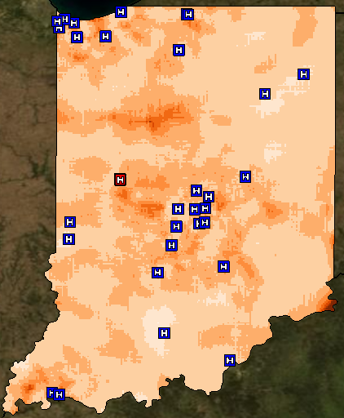

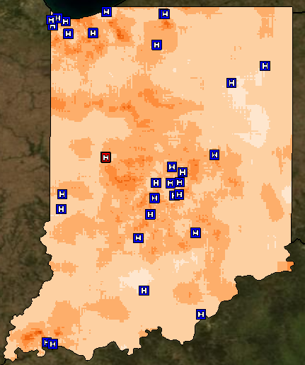
Motion and Animation

Slide 60
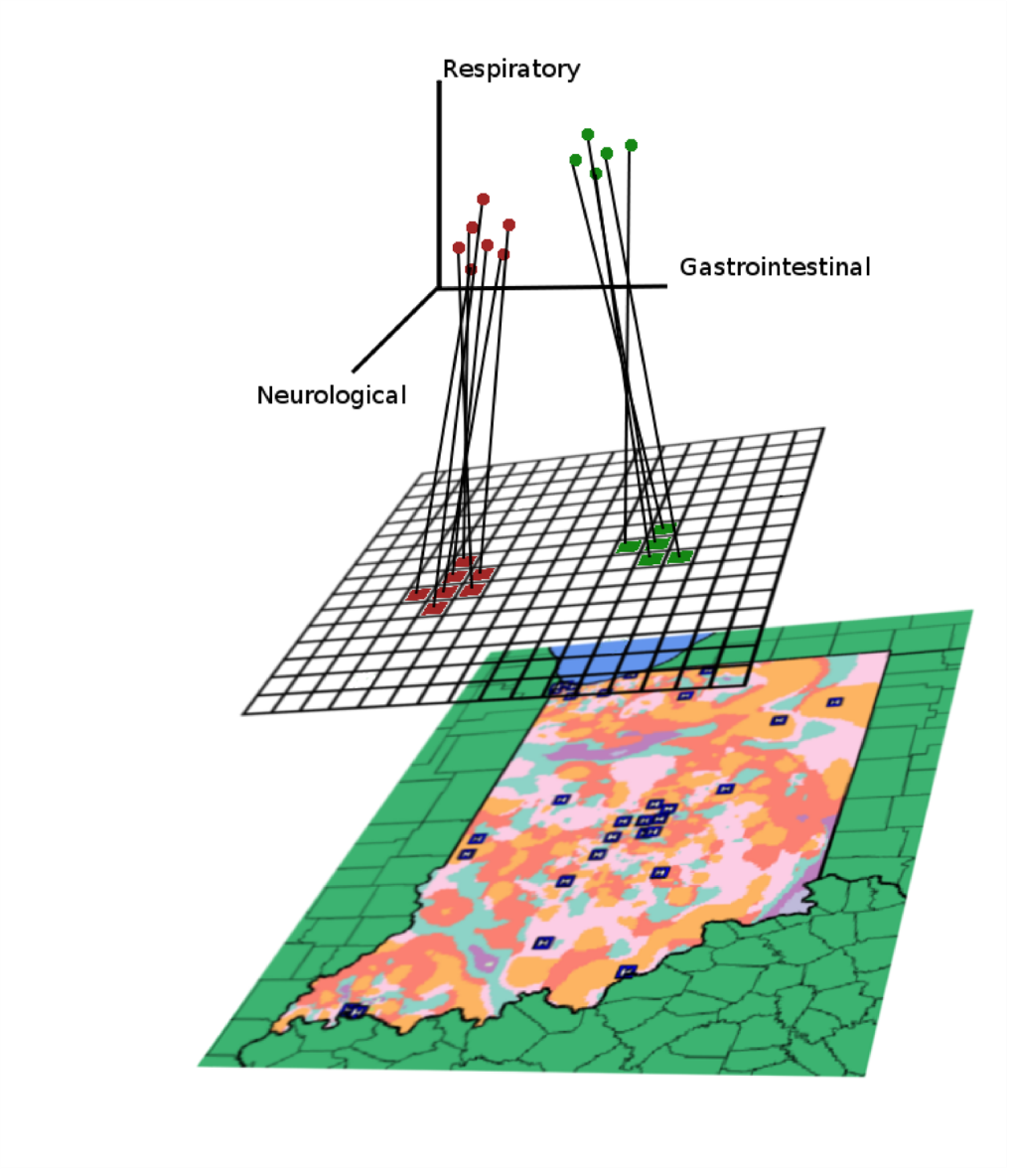
Dimensional Reduction and Analysis Algorithms

Slide 61
Reading & Homework
How to Read a Visualization Research Paper - http://cs.swan.ac.uk/~csbob/research/how2read/laramee09how2read.pdf
Milestone 1 – Due January 29th – You must find a project team, if you are concerned about this contact me as soon as possible!

Slide 62
Questions?

